Slide 1

Hive – A Petabyte Scale Data Warehouse Using Hadoop
Lakshmi Perla, Akhila Atluri, Bhargavi Podile, Kamal Tej Veerapaneni

Slide 2
Table of contents
Introduction
Data Model, Type System And Query Language
Data Storage, Serde And File Formats
System Architecture And Components
Hive Usage In FACEBOOK
Related Work
Conclusions and Future Work

Slide 3

Abstract
Hadoop
open source map reduce project
Stores and process extreme large data sets
using commodity hardware
petabyte scale data
Low level model
Developers should write programs which is hard to maintain and reuse
Size of datasets being collected and analyzed is growing rapidly, making the traditional warehousing solutions prohibitively expensive.
Notes:
The query language is very similar to SQL and therefore can be easily understood by anyone familiar with SQL.
August 2008, open sourced
regularly run thousands of jobs on the Hadoop/Hive cluster

Slide 4


Abstract Solution for the problem
Hive
improved the query capabilities of Hadoop (SQL-like)
maintained the extensibility and flexibility
allows users to extend the system with their own types and functions
Sql-like declarative language HiveQL which can be executed in Hadoop
Hive includes a system catalog –Metastore
EXAMPLE:Hive warehouse in FACEBOOK contains tens of thousands of tables and stores 700TB of data

Slide 5

Introduction
Ad hoc analysis
Business intelligence applications
Insights for the Facebook Ad Network
Facebook's Lexicon product
Problems
Data was growing very fast (from 15TB to 700TB between 2007-2010 )
Some daily data processing jobs were taking more than a day to process
Problem and Solution
A infrastructure that could scale along with such growing data
Simple summarization jobs
Business intelligence
Machine learning applications
Support Facebook product features
Notes:
Facebook was launched on February 4, 2004
In January, 2007
Facebook products are based on analytics
Another words, scalable analysis on large datasets has been core to Facebook

Slide 6
A. Data Model & Type System
Data stored in Tables
Rows
Columns
Primitive types
Complex types
Integers
Bigint (8 bytes)
Int (4 bytes)
Smallint (2 bytes)
Tinyint (1 byte)
Floating point numbers
Float (single precision)
Double (double precision)
String
Associative arrays
map<key-type, value-type>
Lists
list<element-type>
Structs
struct<file-name: field-type, … >

Slide 7
A. Data Model & Type System
Generate types of arbitrary complexity
list<map<string, struct<p1:int, p2:int>>
EXAMPLE
CREATE TABLE t1(st string, fl float, li list<map<string,
struct<p1:int, p2:int>>);
Details
t1.li[0]
t1.li[0]['key']
t1.li[0]['key'].p2
Notes:
represents a list of associative arrays that map strings to structs that contain two integer fields named p1 and p2.
access fields within the structs using a '.' operator.
Values in the associative arrays and lists can be accessed using '[]' operator. Square brackets
t1.li[0] gives the first element of the list
t1.li[0]['key'] gives the struct associated with 'key' in that associative array.
p2 field of this struct can be accessed by t1.li[0]['key'].p2.
Hive is able to support structures of arbitrary complexity.

Slide 8
A. Data Model & Type System
Customize with a jar
Data is prepared by other programs / legacy data
SerDe java interface
ObjectInspector java interface
getObjectInspector method
EXAMPLE
add jar /jars/myformat.jar;
CREATE TABLE t2
ROW FORMAT SERDE 'com.myformat.MySerDe';
Notes:
Hive provides the flexibility to incorporate that data into a table without having to transform the data, which saves a lot of time
any arbitrary data format and types can be plugged into Hive by providing a jar that contains the implementations for the SerDe and ObjectInspector interfaces.
SerDe is short for Serializer/Deserializer. Hive uses the SerDe interface for IO.
A SerDe allows Hive to read in data from a table, and write it back out to HDFS in any custom format.
Anyone can write their own SerDe for their own data formats.
adds a jar containing the SerDe and ObjectInspector interfaces to the distributed cache. so that it is available to Hadoop and
then create the table with the custom serde.

Slide 9
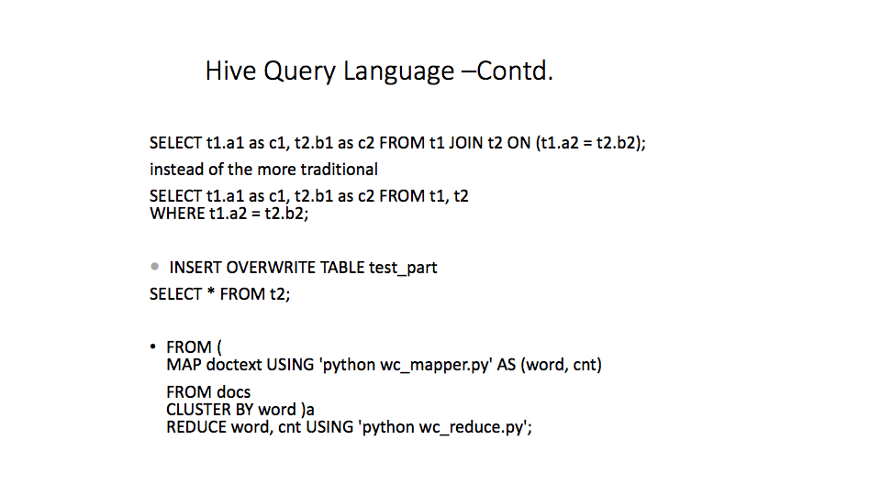
Notes:
Hive currently does not support inserting into an existing table or data partition and all inserts overwrite the existing data.
MAP clause indicates how the input columns (doctext in this case) can be transformed using a user program (in this case ‘python wc_mapper.py') into output columns (word and cnt).
The CLUSTER BY clause in the sub-query specifies the output columns that are hashed on to distributed the data to the reducers and finally the REDUCE clause specifies the user program to invoke (python wc_reduce.py in this case) on the output columns of the sub- query.
Hive provides the DISTRIBUTE BY and SORT BY clauses

Slide 10
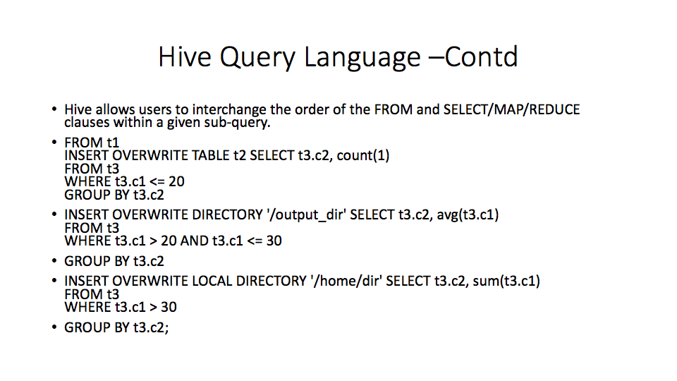
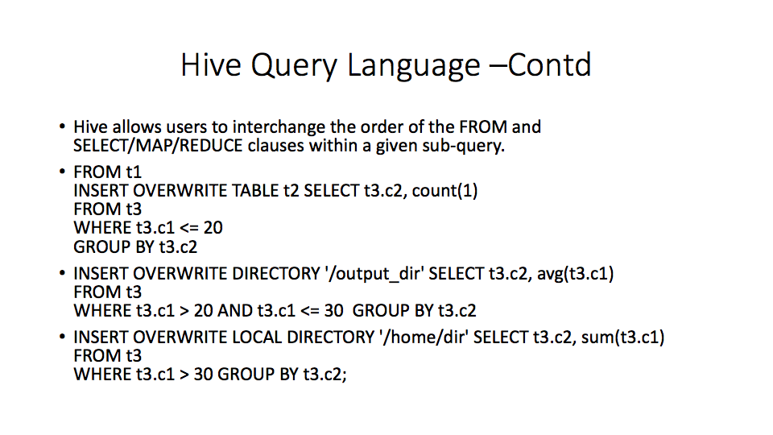

Slide 11
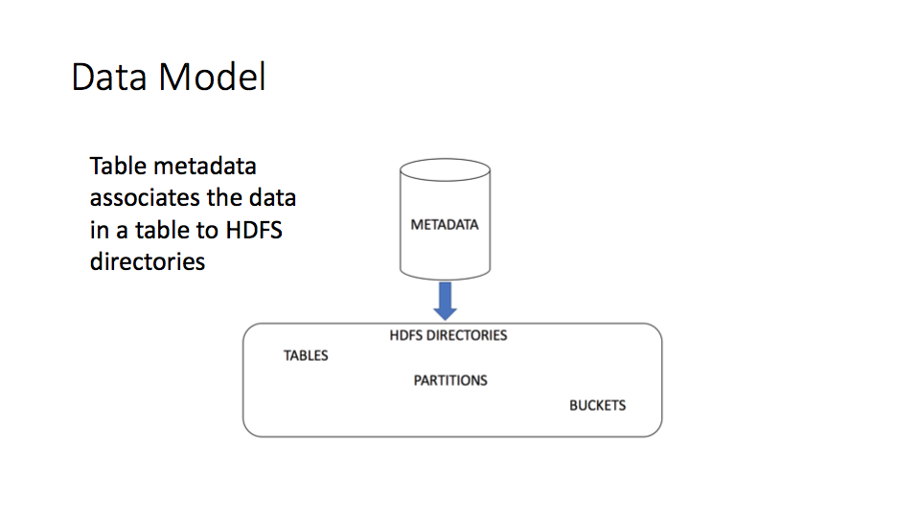

Slide 12
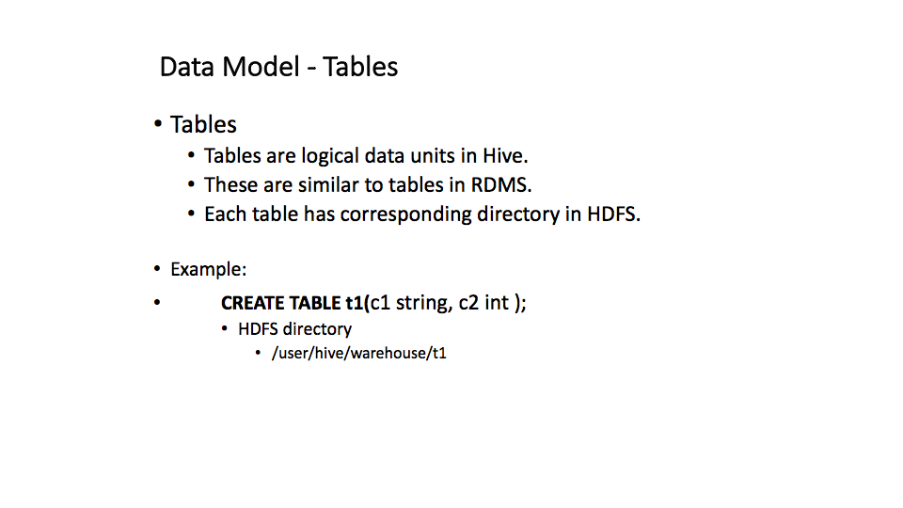

Slide 13

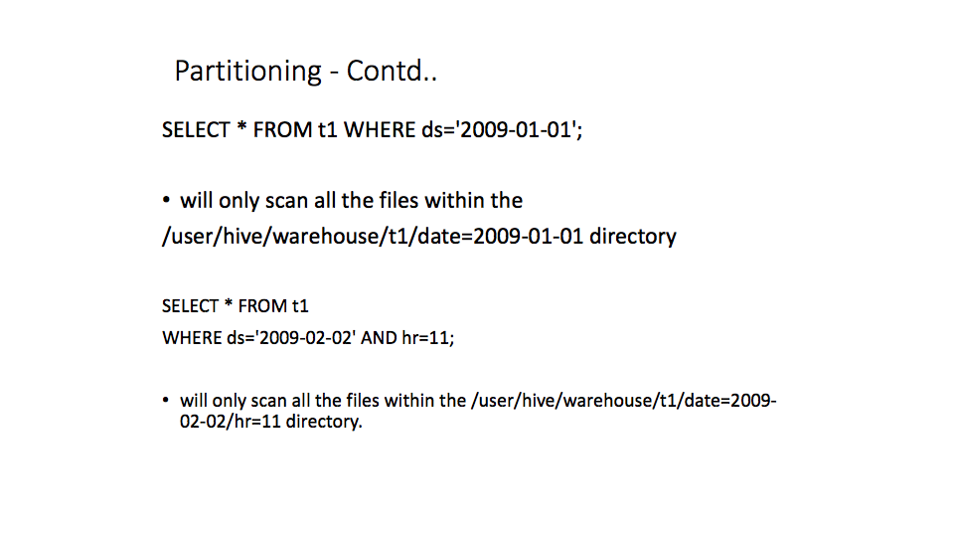
Notes:
1)Used to distribute the load horizontally
2) Has performance benefit
3)helps in organising data in a logical fashion
Example: select * from employee where gives slow query response
By partitioning will create sub directories

Slide 14
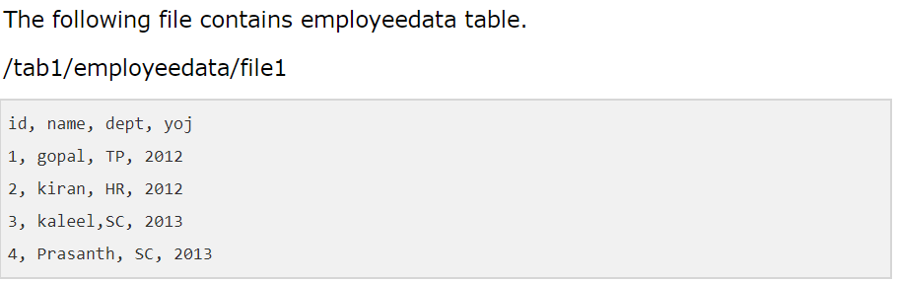
For example a table named emp contains employee data such as id, name, dept, and yoj (i.e., year of joining). Suppose you need to retrieve the details of all employees who joined in 2012.
hive >ALTER table emp
ADD PARTITION(year=‘2012’)
location ‘/2012/part2012’;

Slide 15
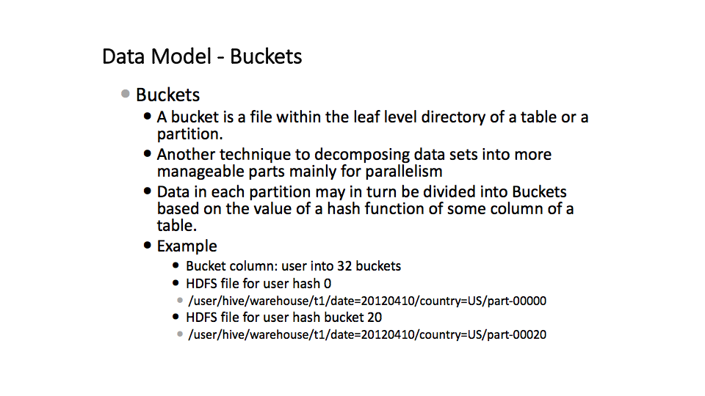
Notes:
Another technique for decomposing the data sets into more manageable parts
Data does not fluctuate using buckets technique

Slide 16
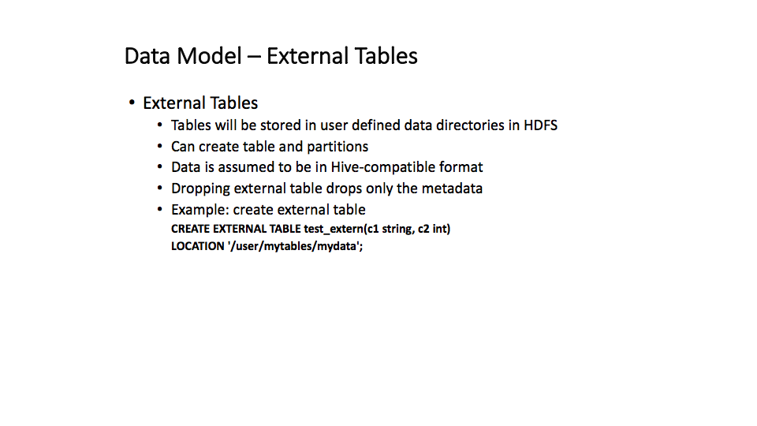

Slide 17
What is SerDe
SerDe is a short name for "Serializer and Deserializer.”
Hive uses SerDe (and FileFormat) to read and write table rows.
Record’s values are written/read using a Hive SerDe
Reading :Hive uses InputFormat to read a record of data (string or binary), passes record to Deserializer.
Deserializer-translates record into java object that Hive can manipulate.
Writing
Serializer-takes a java object that hive has been working with, and turn it into something that hive can write out

Slide 18
Hive SerDe
In serialization structured objects are converted into byte stream
In Deserialization byte stream is converted into series of objects
Hive can take an implementation of the SerDe java interface provided by the user and associate it to a table or partition
As a result custom data formats can easily be interpreted and queried from.The default SerDe implementation in Hive is called the LazySerDe

Slide 19
Lazy SerDe
Default SerDe of Hive is LazySerDe.
The LazySerDe assumes that the data is stored in the file such that the rows are delimited by a newline (ascii code 13) and the columns within a row are delimited by (ascii code 1)
This SerDe can also be used to read data that uses any other delimiter character between columns
Notes:
The SerDe interface allows you to instruct Hive as to how a record should be processed. A SerDe is a combination of a Serializer and a Deserializer (hence, Ser-De). The Deserializer interface takes a string or binary representation of a record, and translates it into a Java object that Hive can manipulate. The Serializer, however, will take a Java object that Hive has been working with, and turn it into something that Hive can write to HDFS or another supported system. Commonly, Deserializers are used at query time to execute SELECTstatements, and Serializers are used when writing data, such as through an INSERT-SELECT statement.
The default serde in hive is called as LazySerDe
Apart from LazySerDe, some other interesting SerDe are present in the hive_contrib.jar that is provided with the distribution. A particularly useful one is RegexSerDe which enables the user to specify a regular expression to parse various columns out from a row.

Slide 20
Continuition of LazySerDe
FIELDS TERMINATED BY '\002'
LINES TERMINATED BY '\012';
SerDe uses (ascii code 2) as a column delimiter and uses (ascii code 12) as a row delimiter.
Delimiters can be specified to delimit the serialized keys and values of maps and different delimiters can also be specified to delimit the various elements of a list (collection)
Notes:
When ever you want read a file into hive you will need to perform deserialization as the content of the file is serialized while it is written.
Deserialization will convert rows into java object.column will be deserialized only if the column of the row is needed in some query.
By default the rows are delimited by new line and colums within row are delimited by CTRL-A (asci 1).
U can use other character as delimiter by specifying the charcter is the query.
Explain query
delimiters can be specified to delimit the serialized keys and values of maps.
different delimiters can also be specified to delimit the various elements of a list (collection).

Slide 21
Example
CREATE TABLE test_delimited2(c1 string, c2 list<map>)
ROW FORMAT DELIMITED
FIELDS TERMINATED BY '\002'
COLLECTION ITEMS TERMINATED BY '\003'
MAP KEYS TERMINATED BY '\004';

Slide 22
SerDes in hive
Apart from LazySerDe, some other interesting SerDes are present in the hive_contrib.jar
A particularly useful one is RegexSerDe which enables the user to specify a regular expression to parse various columns out from a row

Slide 23
Example to intrepret apache logs
CREATE TABLE apachelog( hoststring, identitystring, userstring, timestring, requeststring, statusstring, sizestring, refererstring, agentstring)
ROW FORMAT SERDE 'org.apache.hadoop.hive.contrib.serde2.RegexSerDe’
WITH SERDEPROPERTIES(
'input.regex' = '([^ ]*) ([^ ]*) ([^ ]*) (-|\\[[^\\]]*\\]) ([^ \"]*|\"[^\"]*\") (-|[0-9]*) (-|[0-9]*)(?: ([^ \"]*|\"[^\"]*\") ([^ \"]*|\"[^\"]*\"))?',
'output.format.string' = '%1$s %2$s %3$s %4$s %5$s %6$s %7$s %8$s %9$s');

Slide 24
The input.regex property is the regular expression applied on each record
The output.format.string indicates how the column fields can be constructed from the group matches in the regular expression.
Previous example shows how arbitrary key value pairs can be passed to a serde using the WITH SERDEPROPERTIES clause.

Slide 25
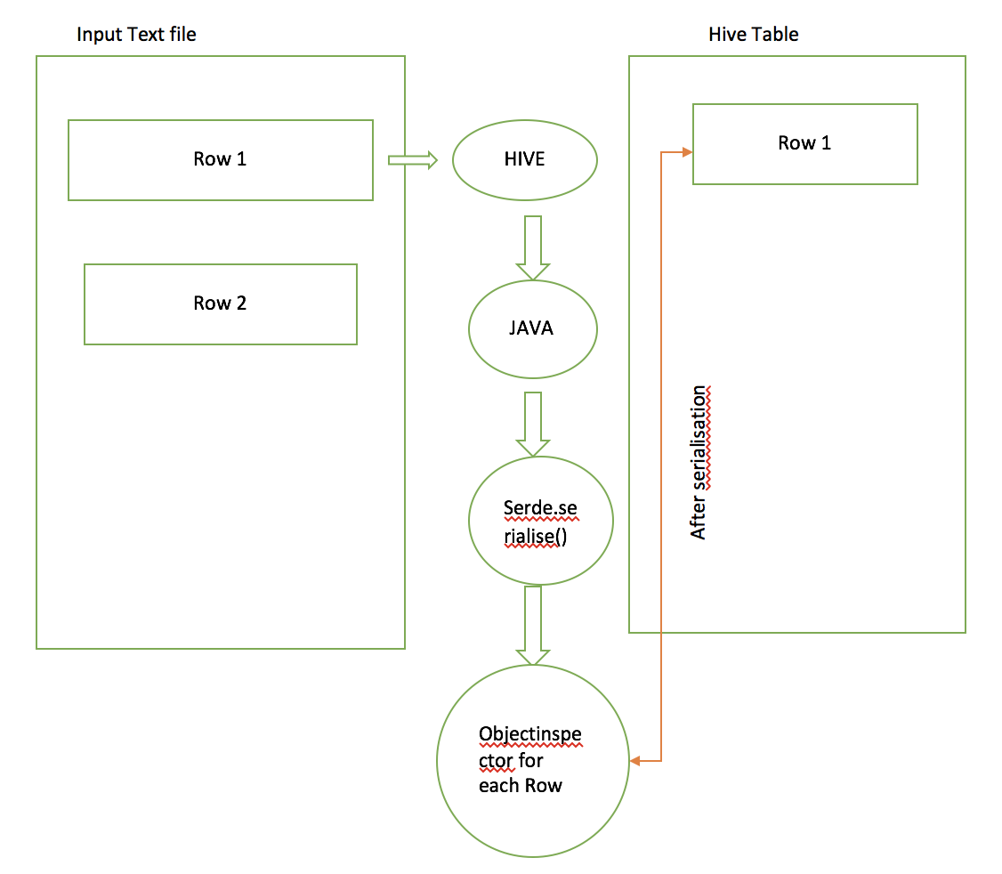
INSERTING DATA FROM TEXT FILE TO HIVE TABLE:

Slide 26
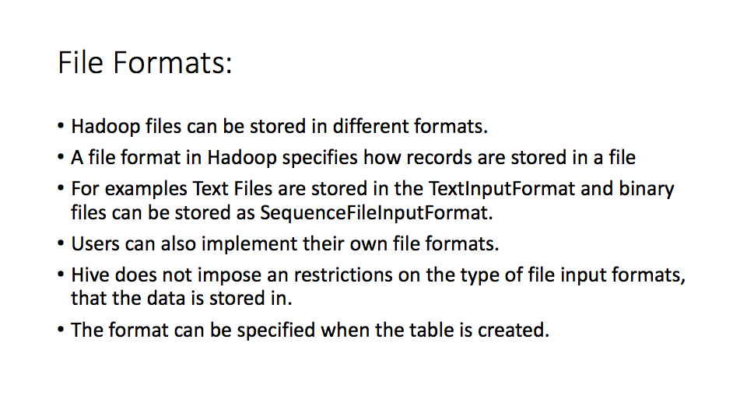

Slide 27
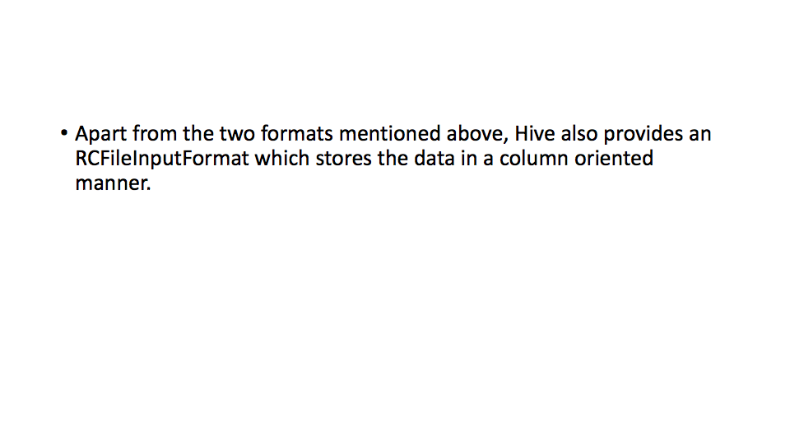

Slide 28
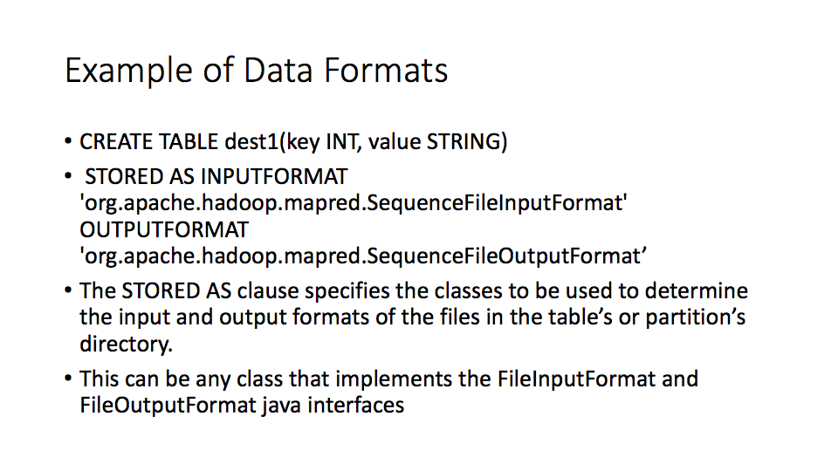

Slide 29
Different Input Formats:
•There are 32 File input formats
•STORED AS TEXTFILE
STORED AS INPUTFORMAT
'org.apache.hadoop.mapred.TextInputFormat'
OUTPUTFORMAT
'org.apache.hadoop.hive.ql.io.IgnoreKeyTextOutputFormat'
And also STORED AS SEQUENCEFILE, RCFILE, AVROFILE, PARQUETFILE, ORCFILE,etc.

Slide 30
Additional notes:
•Settable ObjectInspectors (for write and object creation).
•ObjectInspector allows us to "get" fields, but not "set" fields or "create" objects.
•Settable ObjectInspectors allows that.
We can convert an object with JavaIntObjectInspector to an object with WritableIntObjectInspector easily with the help of Settable ObjectInspectors

Slide 31
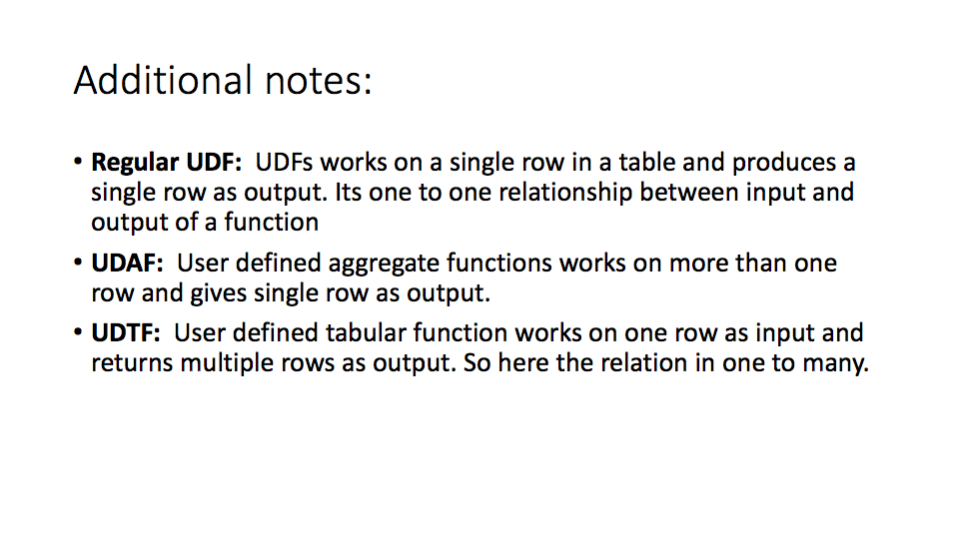

Slide 32
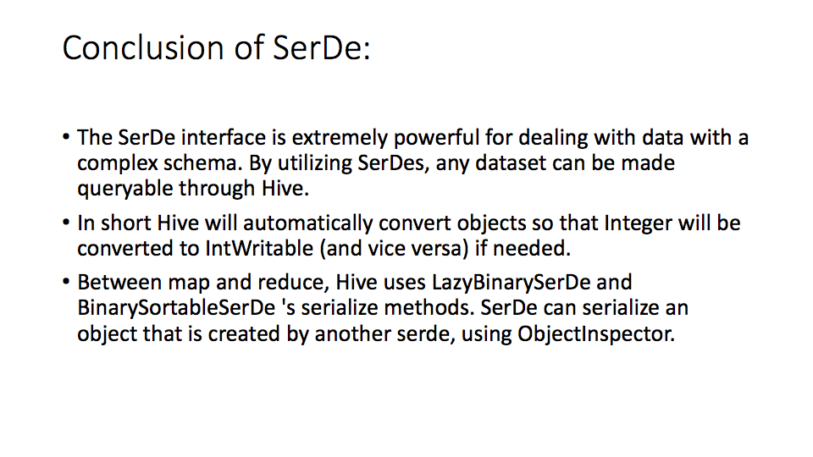
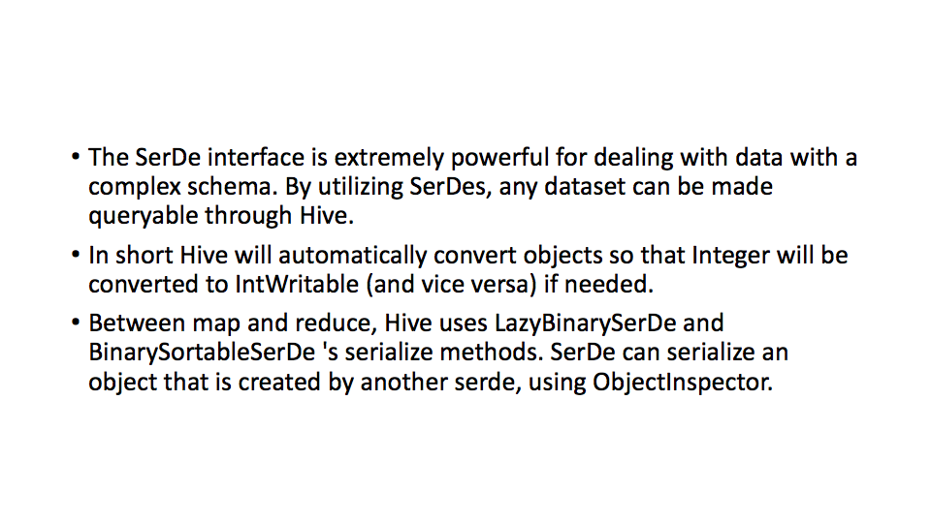

Slide 33
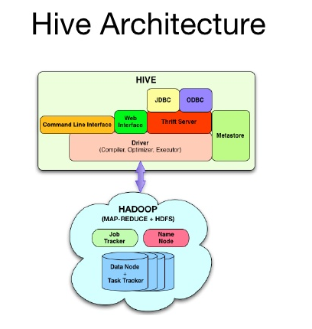

Slide 34
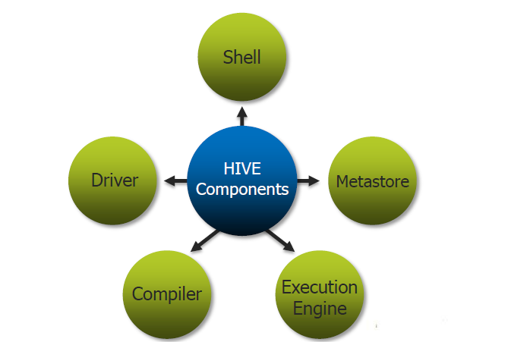
Components
Metastore
The component that stores the system catalog and metadata about tables, columns, partitions, etc.
Driver
The components that manages the lifecycle of HiveQL statements as they move through Hive. The driver also maintains a session handle and any session statistics.
Query compiler
The component that compiles HiveQL into a directed acyclic graph (DAG) of map/reduce tasks.

Slide 35
Components (cont.)
Execution engine
The component that executes the tasks produced by the compiler in proper dependency order. The execution engine interacts with the underlying Hadoop instance.
HiveServer
The component that provides a way of integrating Hive with other applications.

Slide 36
Components (cont..)
Client
Contains Command Line Interface (CLI), the web UI and JDBC/ODBC driver
Extensibility interfaces
Allow users to define their own custom functions
e.g. User Defined Function (UDF)
User defined aggregate function(UDAF)

Slide 37
OVERALL
PROCESS

Slide 38
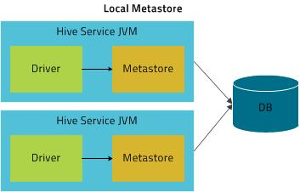
Metastore
In order to serve this info faster to compiler, metastore is storing in RDBMS
Use object-relational mapping (ORM layer) to convert object representations into a relational schema and vice versa
Any metadata that is needed by the mapper or the reducer is passed through the plan.xml files that are generated by the compiler
No direct access to metadata from mapper or reducer
Best practices
Regular backup
Replication

Slide 39
Query compiler
Use metadata stored in the Metastore to generate execution plan
Query parsing
Type checking and semantic analysis
Optimization
Consist of a chain of transformations
The five primary interfaces that are involved in a transformation are Node, GraphWalker, Dispatcher, Rule and Processor.

Slide 40
Query compiler (cont.)
Optimization - transformation
Column pruning
Remove unnecessary columns
Predicate pushdown
Predicates are pushed down to scan so the rows can be filtered early in the processing
Map side joins
Joining small tables with large tables
No reducer is needed

Slide 41
QUERY COMPILER (CONT..)
JOIN REORDERING
Small table in memory
Large table for streaming
Generation of physical plan
The logical plan generated at the end of optimization phase is then split into multiple map/reduce and hdfs tasks.

Slide 42
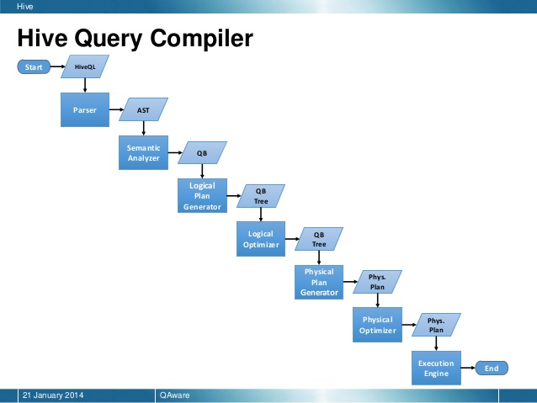

Slide 43
Optimization Techniques (2)
Repartitioning data to handle skew in GROUP BY processing.
First where data is distributed randomly to the reducers and partial aggregation is performed.
In the second stage, these partial aggregations are distributed on GROUP BY columns to different reducers.
Set hive.groupby.skewindata=true;
select t1.c1, sum(t1.c2)
from t1
GROUP BY t1;

Slide 44
Hash Based
Hash bases partial aggregations in the mappers to reduce the data that is sent by the mappers to the reducers which help in reducing the amount of time spent in sorting and merging the resulting data
Here we can observe how it works
‘hive.map.aggr.hashpercentmemory=0.5’;
i.e as soon as hash table size exceeds half of maximum
memory for a mapper, partial aggregates are sent to reducers

Slide 45
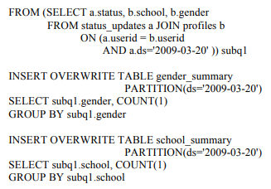
Physical Plan Generation

Slide 46
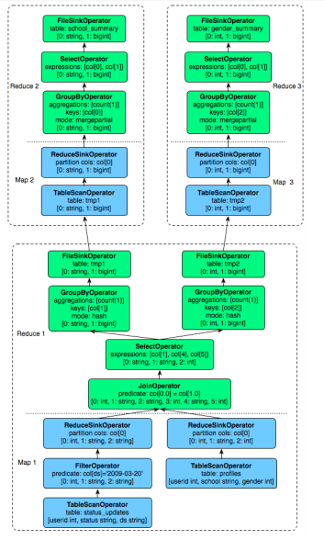
Physical Plan DAG

Slide 47
Execution Engine
Executes the tasks in order of their dependencies.
A MapReduce task first serializes its part of the plan into a plan.xml file. Then file is added to the job cache and mappers and reducers are spawned to execute relevant sections of the operator DAG.
The final results temporary location final destination.

Slide 48
Advantages
Hive ~ SQL with all the simple primitive types and nested data structures.
Execution done by compiler and Hadoop engine. Programmers need to concentrate on queries
The internal design of Hive is complex but clear.

Slide 49
Disadvantages
Main Drawback: Hadoop MapReduce is pretty much the only choice as execution engine for Hive. Since Hadoop is much slower than other distributed execution engine like Spark
I personally prefer the control flow language like Pig Latin over declarative query language like HiveQL
Even from the SQL’s standard, Hive is not complete considering that it doesn’t have update, delete or row level insert operations.
MapReduce is a batch-oriented execution model and has long start overhead

Slide 50
Future work
HiveQL should subsume SQL syntax.
Implement: Cost-based optimizer & Adaptive optimization techniques.
Columnar storage to improve scan performance.
Enhancing JDBS/ODBC drivers for Hive to integrate with other BI tools.
Multi-query optimization and generic n-way join in a single MapReduce job.

Slide 51


